Slide 1
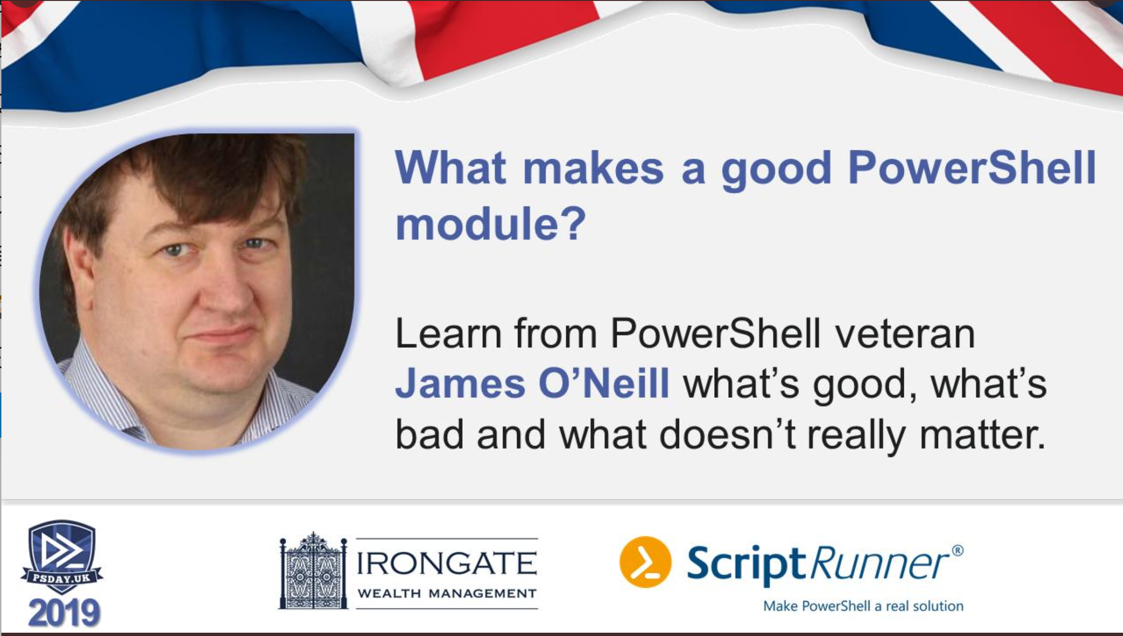

Slide 2
What Makes a Good Shared PowerShell Module
>Get-PresenterDetails –Name "James O'Neill" Twitter Git Mail Blog
------- --- ---- ----
@jamesoneill jhoneill j@mobulaConsulting.com Jamesone111.wordpress.com

Slide 3
>Get-PresenterDetails –Name "James O'Neill" Twitter Git Mail Blog
------- --- ---- ----
@jamesoneill jhoneill j@mobulaConsulting.com Jamesone111.wordpress.com

Slide 4

The advice I’m revisiting
Re-usable Functions which each do one task
Scripts for specific, complex Jobs
Write for the pipeline
Use Write- and Out- properly
Choose names wisely
Make parameters flexible,
and make some constants parameters
Notes:
COMPOSEABLE

Slide 5
The advice I’m revisiting
Use –WhatIf
Handle error conditions well
Provide help, including examples

Slide 6
What is/was this advice trying to achieve ?

Slide 7
Four “REs” we want
Reliability
It does what we expect, when used as the author expected
Does it even say what it does (and expectations) ?
Reusability
The author allowed additional use cases
Recyclability
When we want to do something the author didn’t expect.
Repairability
When it doesn’t do what [we think] it says, we can fix it

Slide 8
Doing what it says …

Slide 9
We release our modules into the world…
Module will be run
By people you don’t know
In ways you won’t understand
On systems you can’t access
Everything that ever worked, must always work

Slide 10
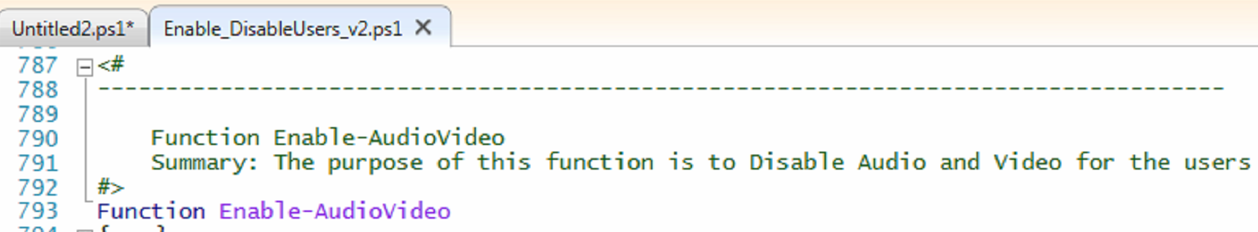
Say what it does …
The name should be a clue
Include .SYNOPSIS and .EXAMPLE
Each .EXAMPLE is a contract with users and the basis for a simple [Pester] test script

Slide 11
“Fettle Widgets” help
Some 1990s App
“Press this button if you want widgets to be fettled”
It doesn’t tell me
What a widget is,
What fettling does
or why I would want to do it.
“Tweet length” help is often enough
Fettle Widgets
#Balance Users Switch
[switch] $BalanceUser

Slide 12
Help is under-rated
Write Synopsis , Examples, Parameter help as early as you can
They are your contract with the user and keep you focused
Fundamental to “Can I put this to use ?”
Looking at the code is not the answer
Documentation is both an investment....
So, save a little in the jar every day…
… And an early casualty of resource pressure → Technical debt
Testing is also a casualty … so Help = Test
You will not “do it at the end”

Slide 13
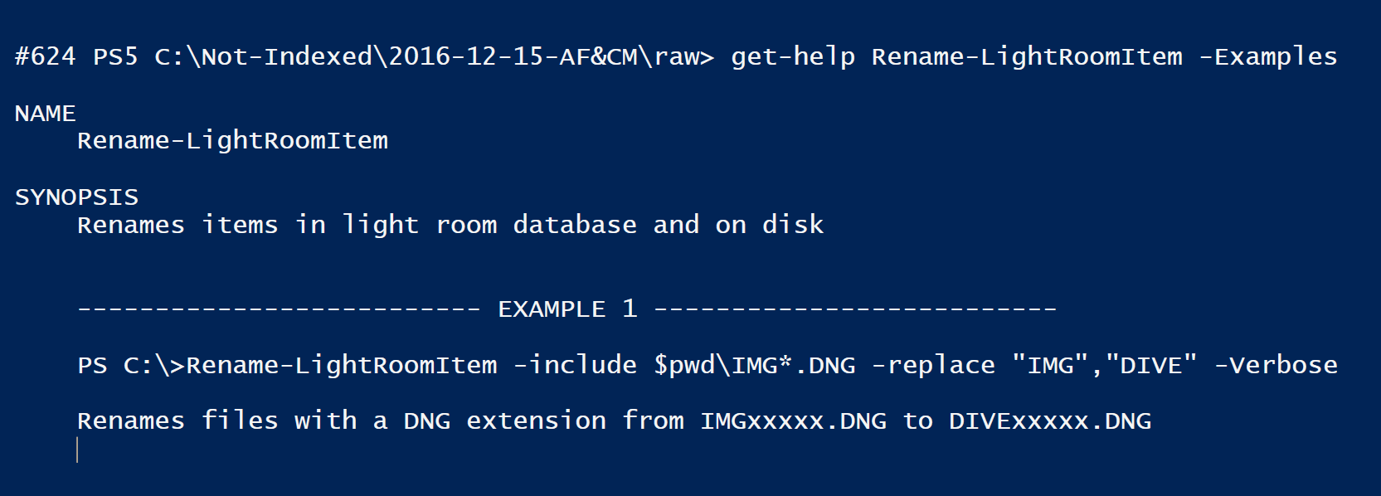
Examples in Help
Can highlight bad design / silly assumptions
The start of a test script.
That way you use the command … .. the one you will have forgotten in a few weeks … Copy, paste, type one line of explanation.

Slide 14
Help
Test
Spec
Synopsis and description specify what it does
Parameter descriptions and examples show how
Check that examples [still] work
Tests [should] make good examples
Pester outline IS a functional spec
More detail at https://jamesone111.wordpress.com/2016/05/31/help-spec-test/

Slide 15
How does it do it ?
> get-help set-camera -Examples
NAME
Set-Camera
SYNOPSIS
Sets the camera options **without checking validity**
-------------------------- EXAMPLE 3 --------------------------
PS C:\>Set-Camera "sv=auto","xv=0.0","","effect=cim_natural"
Sets multiple options: ISO (Sensitivity Value) to auto...
Help is a contract to
Deliver the spec
Test contains example
What can it do ?
Describe "Pentax Camera control script" {
It "Formats shutter speeds correctly" {}
It "Handles the camera being disconnected" {}
It "Sets the camera to the program line" {}
It "Sets multiple camera settings" {}
It "Can get raw camera settings" {}
It "Formats camera settings" {}
It "Can focus the camera" {}
It "Can take a picture" {}
It "Can Shoot and download a picture" {}
It "Can get the list of files on the camera" {}
It "Can get the latest picture info" {}
It "Can get information for a named picture" {}
It "Allows piping into Request-CameraPicInfo" {}
It "Can copy a named picture from the camera" {}
It "Allows piping into Copy-CameraPic" {}
It "Handles requests for invalid filenames" {}
}
Prove that it does it
It "Sets multiple camera settings" {
$settings = Set-Camera "sv=auto","xv=0.0","","effect=cim_natural"
$settings.count | should be 4 $settings[0] | should match "Sv=\d" #etc. }
Each line of the description (spec)
Expands to a test

Slide 16
Nearly there with meeting users’ expectations …
It says what it does, and does what it says. That isn’t quite enough
Users will expect similar experiences throughout PowerShell …
Make it “Powershelly”

Slide 17
We didn’t always program that way
$h = Read-Host "Enter the height"
$r = Read-Host "Enter the radius"
$crossSection = [math]::PI * $r * $r
Write-Host -ForegroundColor Cyan "The cross sectional area is $crossSection"
$volume = $crossSection * $h
Write-Host -ForegroundColor cyan "The volume is " -NoNewline
Write-Host -ForegroundColor Green $volume
Enter the height: 10
Enter the radius: 5
The cross sectional area is 78.5398163397448
The volume is 785.398163397448
Do not write like this

Slide 18
Param (
[parameter(Mandatory=$true, HelpMessage = "Please enter the height of the cylinder")]
$Height ,
[parameter(Mandatory=$true, HelpMessage = "Please enter the radius of the cylinder")]
$Radius
)
$crossSection = [math]::PI * $Radius * $Radius
Write-Verbose "The cross sectional area is $crossSection"
$volume = $crossSection * $Height
$volume

Slide 19
Users expect commands to:
Use parameters with standard names
Output properly.
Keep them informed without being [too] chatty – use Write-Progress and Write-Verbose
Accept multiple targets (via pipeline, wildcard or list)
Use switches (avoid Booleans)
Support –Whatif
Specifying cmdletbinding has additional benefits
Require no knowledge of inner workings
Convert wildcards from * to %
Use validation to HELP user; not to save yourself work.

Slide 20
Bad Validation
Be very careful with Validate pattern
> test "c:"
Test : Cannot validate argument on parameter 'Path'. The argument "c:" does not match the "^\\\\\S*\\\S*$" pattern. Supply an argument that matches "^\\\\\S*\\\S*$" and try the command again

Slide 21
Good validation
[ValidateSet("Aperture", "CameraModel", "Caption" ...)]
$Where

Slide 22
Help the user with input.
Validate sets and argument completers
Validate set helps intellisense: must supply a member of the set
So do Argument completers: can ignore the suggestion
V5 allows has richer support, and V6 has dynamic ValidateSets.
Long write up: https://jamesone111.wordpress.com/2019/09/23/the-classy-way-to-complete-and-validate-powershell-parameters/
Short version: if you can predict values, make [tab] do the work

Slide 23
Make errors tidy…
Don’t mess with error action preference
Use –ErrorAction SilentlyContinue if errors are expected
try with empty catch {} is ok if –errorAction doesn’t work (e.g. Get-ADuser)
Be careful with throw
Catch {throw $Error[0].Exception.Message}
May make the error worse –and can hide where it happened

Slide 24
Demo : Error handling as expected ?

Slide 25
Biggest need to rewrite
Scripts which are too concerned with printing output to screen
Write-Host Because coloured output is important.
Cls considered harmful ! What did you want in the back scroll buffer I cleared?
Converting to string / Formatted output / Returning just one property
At least offer a –Raw option !
Not hard to expose properties (hash-tables , or custom objects)
If it refers to files (etc.) make sure it pipes into things which work on files!
Custom types with formatting XML is the ideal, but isn’t always needed
[OutputType] helps intellisense

Slide 26
Allowing new use cases
First step: be pipeline aware
Moving from specific to general can be as simple as making “Constants” the defaults for parameters
Days of data, Input / Output file names etc.
Just move them to the param() block !

Slide 27
Code vs documentation
People may want to use your code, but they don’t want to read it.
If it is not self explanatory, they might use it, but they will hate you.
We only want to look at code if
We are repairing something broken
We are recycling / adapting code
And when we do we need good signposts
Documentation is both an investment (so, save a little in the jar every day) and an early casualty of resource pressure

Slide 28
Making your code Nice to work on

Slide 29
Yes, we know about comments…
Write-Verbose, and Write-Progress do the job of comments so do #region … #end region
Aliases
There isn’t one true style for braces, indents etc. … However
Toggle region expansion in the ISE / Visual studio Code. Good style works well collapsed.
Remember vertical space is at a premium on a landscape monitor
But don’t obsess on layout

Slide 30
Good Habits…
Start with the style guide.
https://github.com/PoshCode/PowerShellPracticeAndStyle
Use the PsScriptAnalyzer (built in with VS Code)
Source control (e.g. GitHub)
Change history, Backup and sharing all in one
Think about splitting/combining files (and comment based vs external help)
Compiled cmdlets ?
Signatures ?

Slide 32
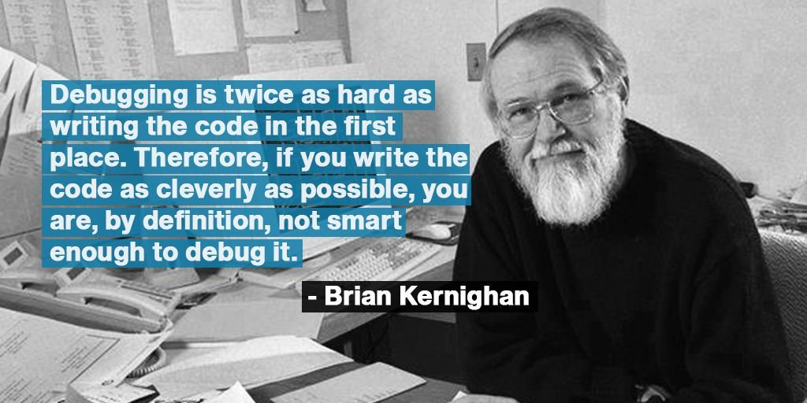
Consistency
Can be over done. But:
Don’t do the same thing many different ways
Prefer the familiar way to the clever way
Clever may be opaque (comment it)
That one-line might be clearer as multiple commands
Might just be unfamiliar
@codewisdom

Slide 33
Samples of strange practice
$c = gc env:systemdrive
$prog86 = "${env:ProgramFiles(x86)}"
$Logfile = "$c\xxSCRIPT\Script-$(gc env:computername)-$now.log"
$env:SystemDrive etc.
Set-Variable -Scope 1 -Name "variableName" -Value $($variableName +1)
$Script:VariableName ++
switch ($bool) {
$true {"It is true"; Break}
default {Continue}
}
if ($bool) {"It is true"}

Slide 34
A couple more
Get-ThingOne -filter "blue" | Get-ThingTwo -filter "Big" | Get-ThingThree -filter "New" | Group-Object -Property Opinion | sort count | Select-Object -Last 1 -ExpandProperty group | sort Name | Select-Object -Property Hue,Size,age,opinion | export.csv -path data.csv
$Stuff = Get-ThingOne -filter "blue" | get-ThingTwo -filter "Big" | get-ThingThree -filter "New"
$mostCommon = $Stuff | Group-Object -Property Opinion | sort count | select -last 1 -expand group
$mostCommon | sort-object -Property Name | Select-Object -Property Hue,Size,age,opinion | export.csv -path data.csv
if ($x = Get-Something) {Process $x}
$x = Get-Something
if ($x) {Process $x}

Slide 35
Names should be informative …
$Stuff = Get-ThingOne -filter "blue "| Get-ThingTwo
Functions should do one task completely.
Are these two halves of a task ? Or the same task with different parameters? https://jamesone111.wordpress.com/2019/04/06/powershell-functions-and-when-not-to-use-them/
Avoid names like “Stuff” “Data”
Everything is data of some kind!
A good name reduces the understanding the command line needs
Confine single character names to loop variables and similar
Tip. Lower case first char = local variable. Upper case, Parameters etc.

Slide 36
Don’t just write to get the job done
Write to be understood
Layout
Comments & Pseduo comments
Avoid aliases !
Be [more] explicit with parameters
Check with PSScriptAnalyzer
Prefer the familiar way
Write for you, in six months, at 3A.M, with everything on fire … (or for an axe wielding colleague who knows where you live)

Slide 37
Conclusion: signs to look for
Is it clear about what it does ?
Does it work like other things we use ?
Including running “hands off”, and participating in pipelines
Is it smart about its input and output ?
Does it actively assist the user ?
If we have to look inside, can we understand it quickly ?

Slide 38
James O’Neill
@jamesoneill
j@mobulaConsulting.com
Jamesone111.wordpress.com

Slide 40
Title and Content
Level one: message
Level two: paragraph
Level three: bullet 1
Level four: bullet 2
Level five: bullet 3

Slide 41
Title and Two Content
Level one: message
Level two: paragraph
Level three: bullet 1
Level four: bullet 2
Level five: bullet 3
Level one: message
Level two: paragraph
Level three: bullet 1
Level four: bullet 2
Level five: bullet 3

